Slide 1


MATHEMATICS
GRADE 2
YEAR 2
TERM 1

Slide 2
OUTLINE
Duration | Content Area | Topic
Week 1 & 2 | Numbers, Operations and Relationships Data handling | Count forwards in 1s from any number up to 20 Sort concrete objects according different attributes e.g. colour, shape, size
Week 3 | Numbers, Operations and Relationships Measurement | Recognise, identify and read number symbols up to 1-20 Place birthdays on a chart
Week 4 | Numbers, Operations and Relationships Space and shape | Solve simple word problems in context involving, equal sharing and grouping up to 10 Describe, sort and compare 3D objects in terms of: size, colour and shape
Week 5 | Numbers, Operations and Relationships Measurement | Solve simple word problems in context involving addition and subtraction with answers up to 10 Compare and order the mass of two or more objects using a balancing scale
Week 6 | Numbers, Operations and Relationships Data handling | Addition and subtraction up to 10 Use pictures to represent data in pictograph

Slide 3
Outline cont…
Duration | Content Area | Topic
Week 7 | Numbers, Operations and Relationships | Recognise, identify and read number names 1-20 Write number symbols 1-10 Copy and extend simple number sequence to at least 10
Week 8 | Numbers, Operations and Relationships | Describe, compare and order numbers 1-15 and recognise: more, less and equal to
Week 9 | Numbers, Operations and Relationships | Add the same number repeatedly up to 10
Week 10 | Numbers, Operations and Relationships | Recognise and identify the South African coins, R1,R2, R5 and the bank notes R10, R20, R50 and R100

Slide 4
Week 1 & 2
Count forwards in 1s from any number up to 20
Sort concrete objects according different attributes e.g. colour, shape, size

Slide 5
Group 1
Task 1: Colour as you count from 1 all the way to 20
1 | 2 | 3 | 4 | 5 | 6 | 7 | 8 | 9 | 10
11 | 12 | 13 | 14 | 15 | 16 | 17 | 18 | 19 | 20

Slide 6
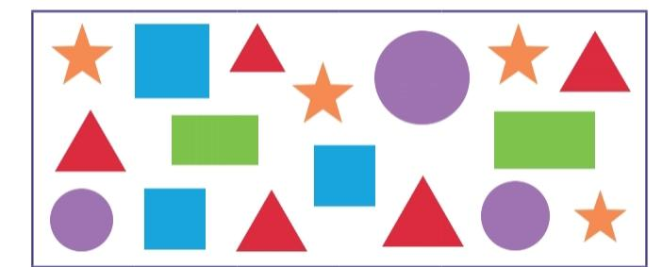
Group 1
Task 2: Cut out the shapes and paste them on the graph below.

Slide 7
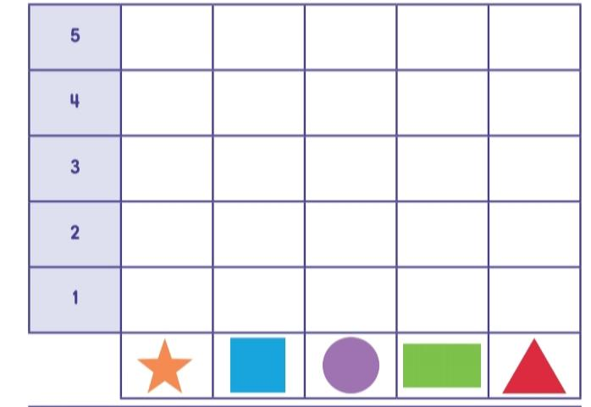
Task 2 cont…

Slide 8
Group 2
Task 1: Trace as you count the numbers from 1 all the way to 20.
1 | 2 | 3 | 4 | 5 | 6 | 7 | 8 | 9 | 10
11 | 12 | 13 | 14 | 15 | 16 | 17 | 18 | 19 | 20

Slide 9
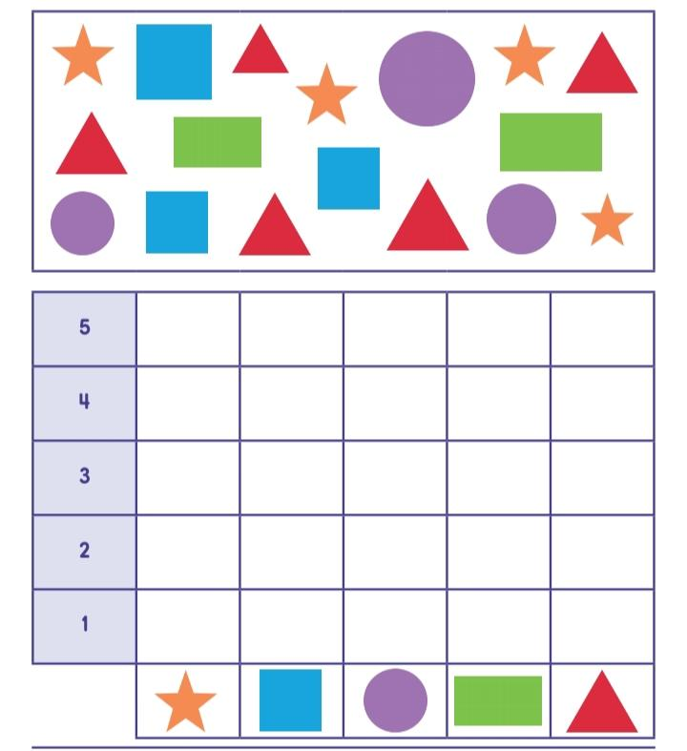
Group 2
Task 2: Count the shapes and colour in on the chart below.

Slide 10
Group 3
Task 1: Write the numbers from 1 all the way to 20 below.

Slide 11
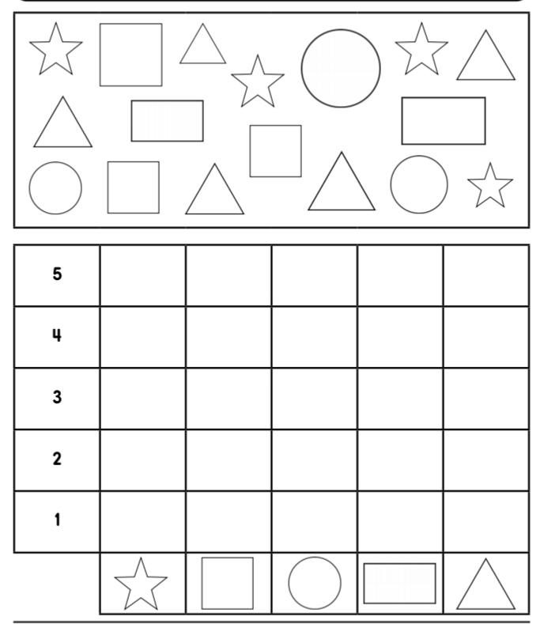
Group 3
Task 1: Count the shapes and colour in on the chart below. Then answer questions.

Slide 12
Task 2 cont…
The are the most.
The are the least.

Slide 13
Week 3
Recognise, identify and read number symbols up to 1-20
Place birthdays on a chart

Slide 14

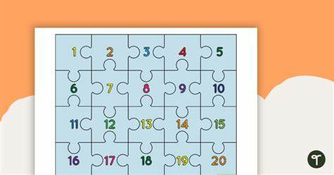
Group 1
Task 1: Cut and complete the number puzzle below.

Slide 15

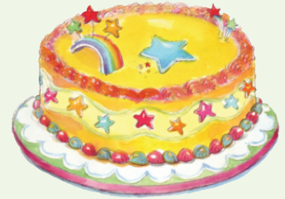
Group 1
Task 1: Look at the picture and talk about how old you are.

Slide 16
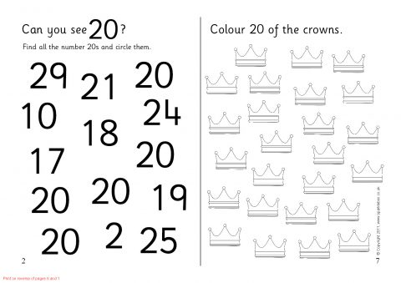
Group 2
Task 1: Colour 20 crowns.

Slide 17
Group 2
Task 2: Draw candles on this cake to show how old you are.

Slide 18
Group 3
Task 1: Draw 20 objects.

Slide 19
Group 3
Task 2: Draw a cake with candles to show how old you are.

Slide 20
Week 4
Solve simple word problems in context involving, equal sharing and grouping up to 10
Describe, sort and compare 3D objects in terms of: size, colour and shape

Slide 21

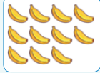
Group 1
Task : Group the counters into 2 equal groups

Slide 22
Group 1
Task 1: Colour the balls with purple and the boxes with yellow .

Slide 23
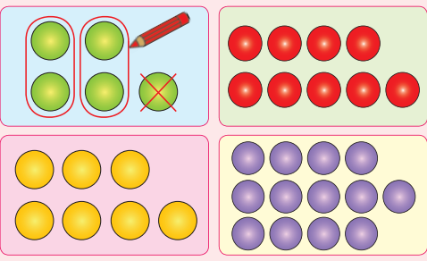
Group 2
Task 1: Group the counters into 2 equal groups and put a cross on the remaining counters.

Slide 24
Group 2
Task 2: Trace and colour all balls purple and the boxes yellow..

Slide 25
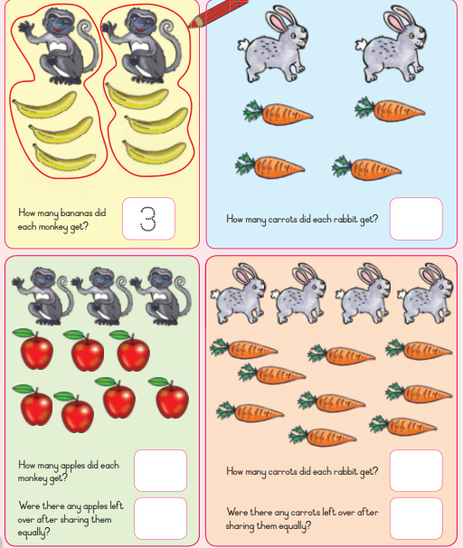
Group 3
Task 1: Circle the fruit and animals to share them equally.

Slide 26
Group 3

Slide 27
Week 5
Solve simple word problems in context involving addition and subtraction with answers up to 10
Compare and order the mass of two or more objects using a balancing scale

Slide 28
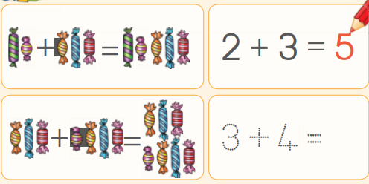
Group 1
Task 1: Add these sweets an d then fill in the answers

Slide 29
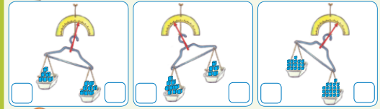
Group 1
Task 2: Circle the container that is heavier

Slide 30
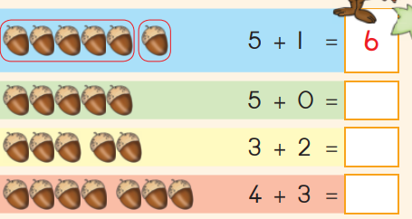
Group 2
Task 1: Add the numbers.

Slide 31
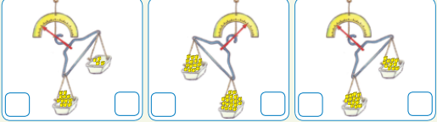
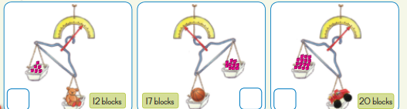
Group 1
Task 2: Count the blocks in each container. Then circle the container that is lighter.

Slide 32
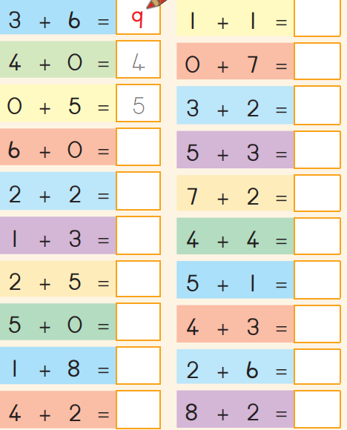
Group 3
Task 1: Add the numbers

Slide 33
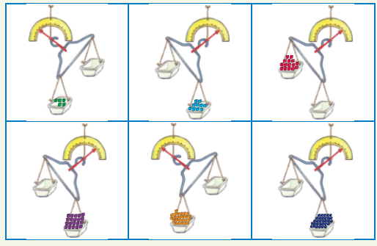
Group 3
Task 1: Draw an object that is heavier or lighter than the blocks.

Slide 34
Week 6
Addition and subtraction up to 10
Use pictures to represent data in pictograph

Slide 35
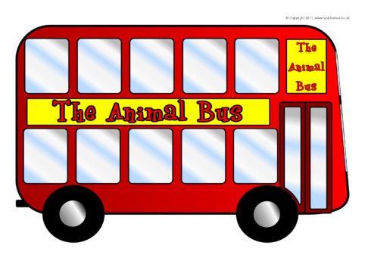
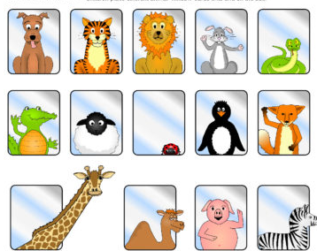
Group 1
Task 2: Cut and paste each animal flash card on the bus windows.

Slide 36
Group 1

Slide 37
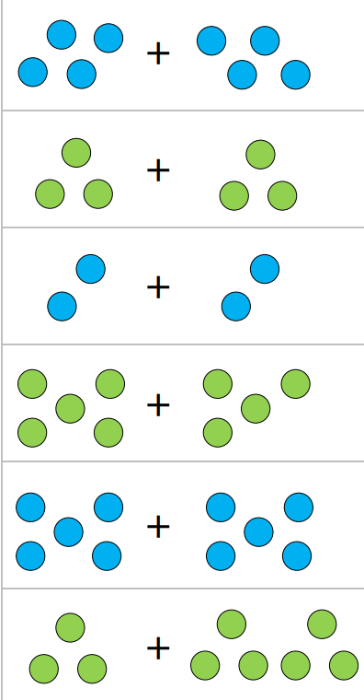
GROUP 2
Task 1: Count and draw circles to show the sums.

Slide 38
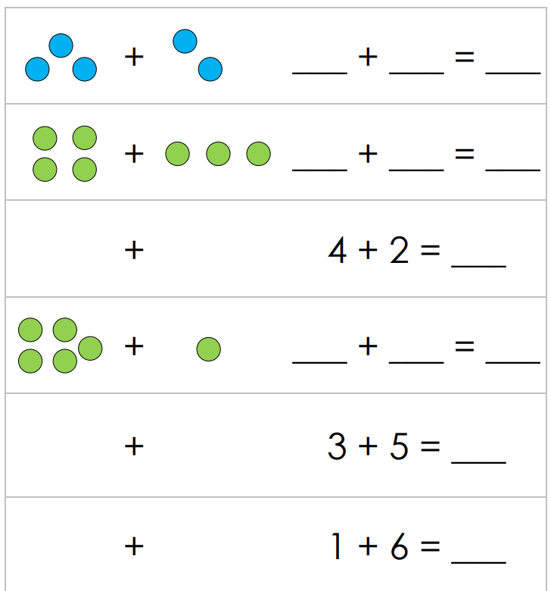
GROUP 3
Task 1: Count / draw circles, read / write numbers and find the sums.

Slide 39
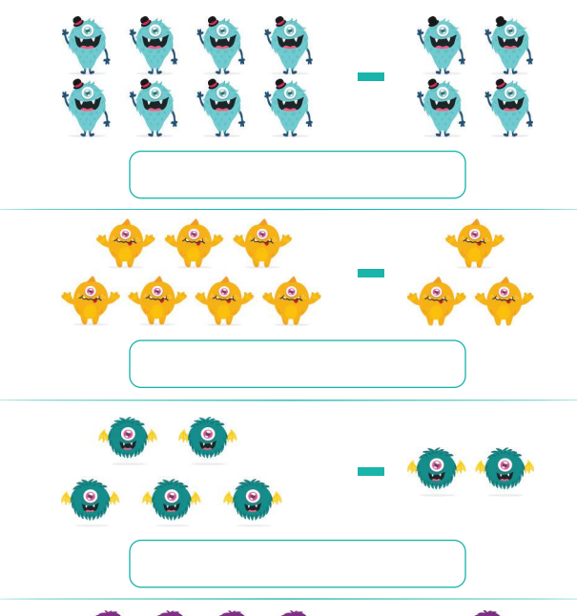
GROUP 3
Task 2: Some monsters are taken away. Write the subtraction sentence in the box

Slide 40
Task …

Slide 41
GROUP 3
Task 2: Draw your favourite water animals.

Slide 44
ASSESSMENT GOALS
Explain and compare the purpose of the homes of animals

Slide 45
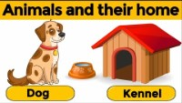
ANIMALS AND THEIR SHELTERS

Slide 46
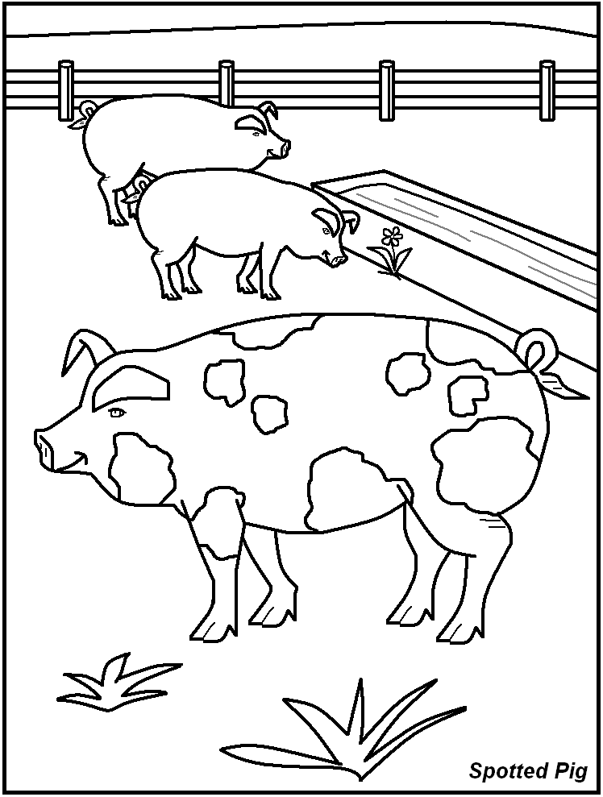
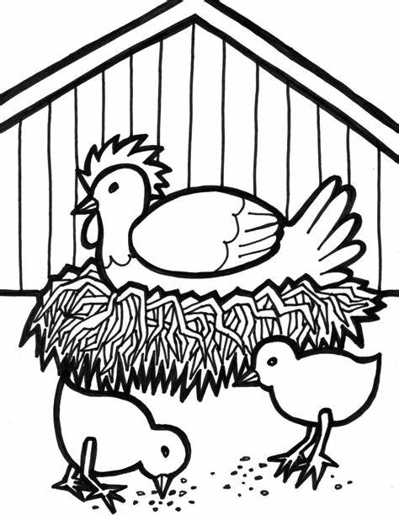
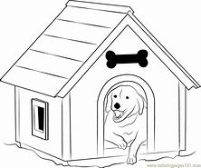
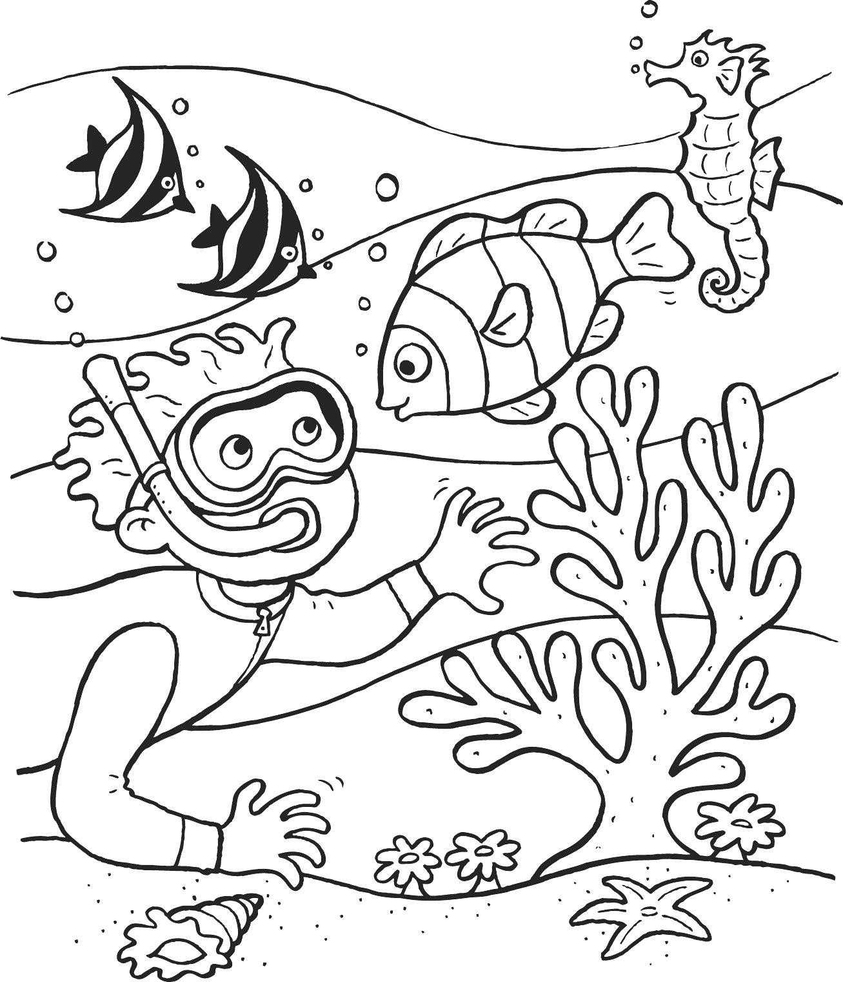
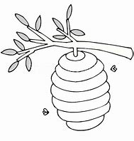
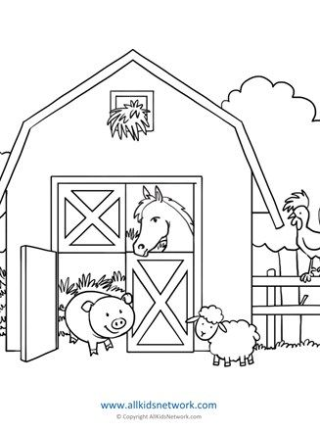
Group 1
Task 1: Colour the animal homes below.

Slide 47
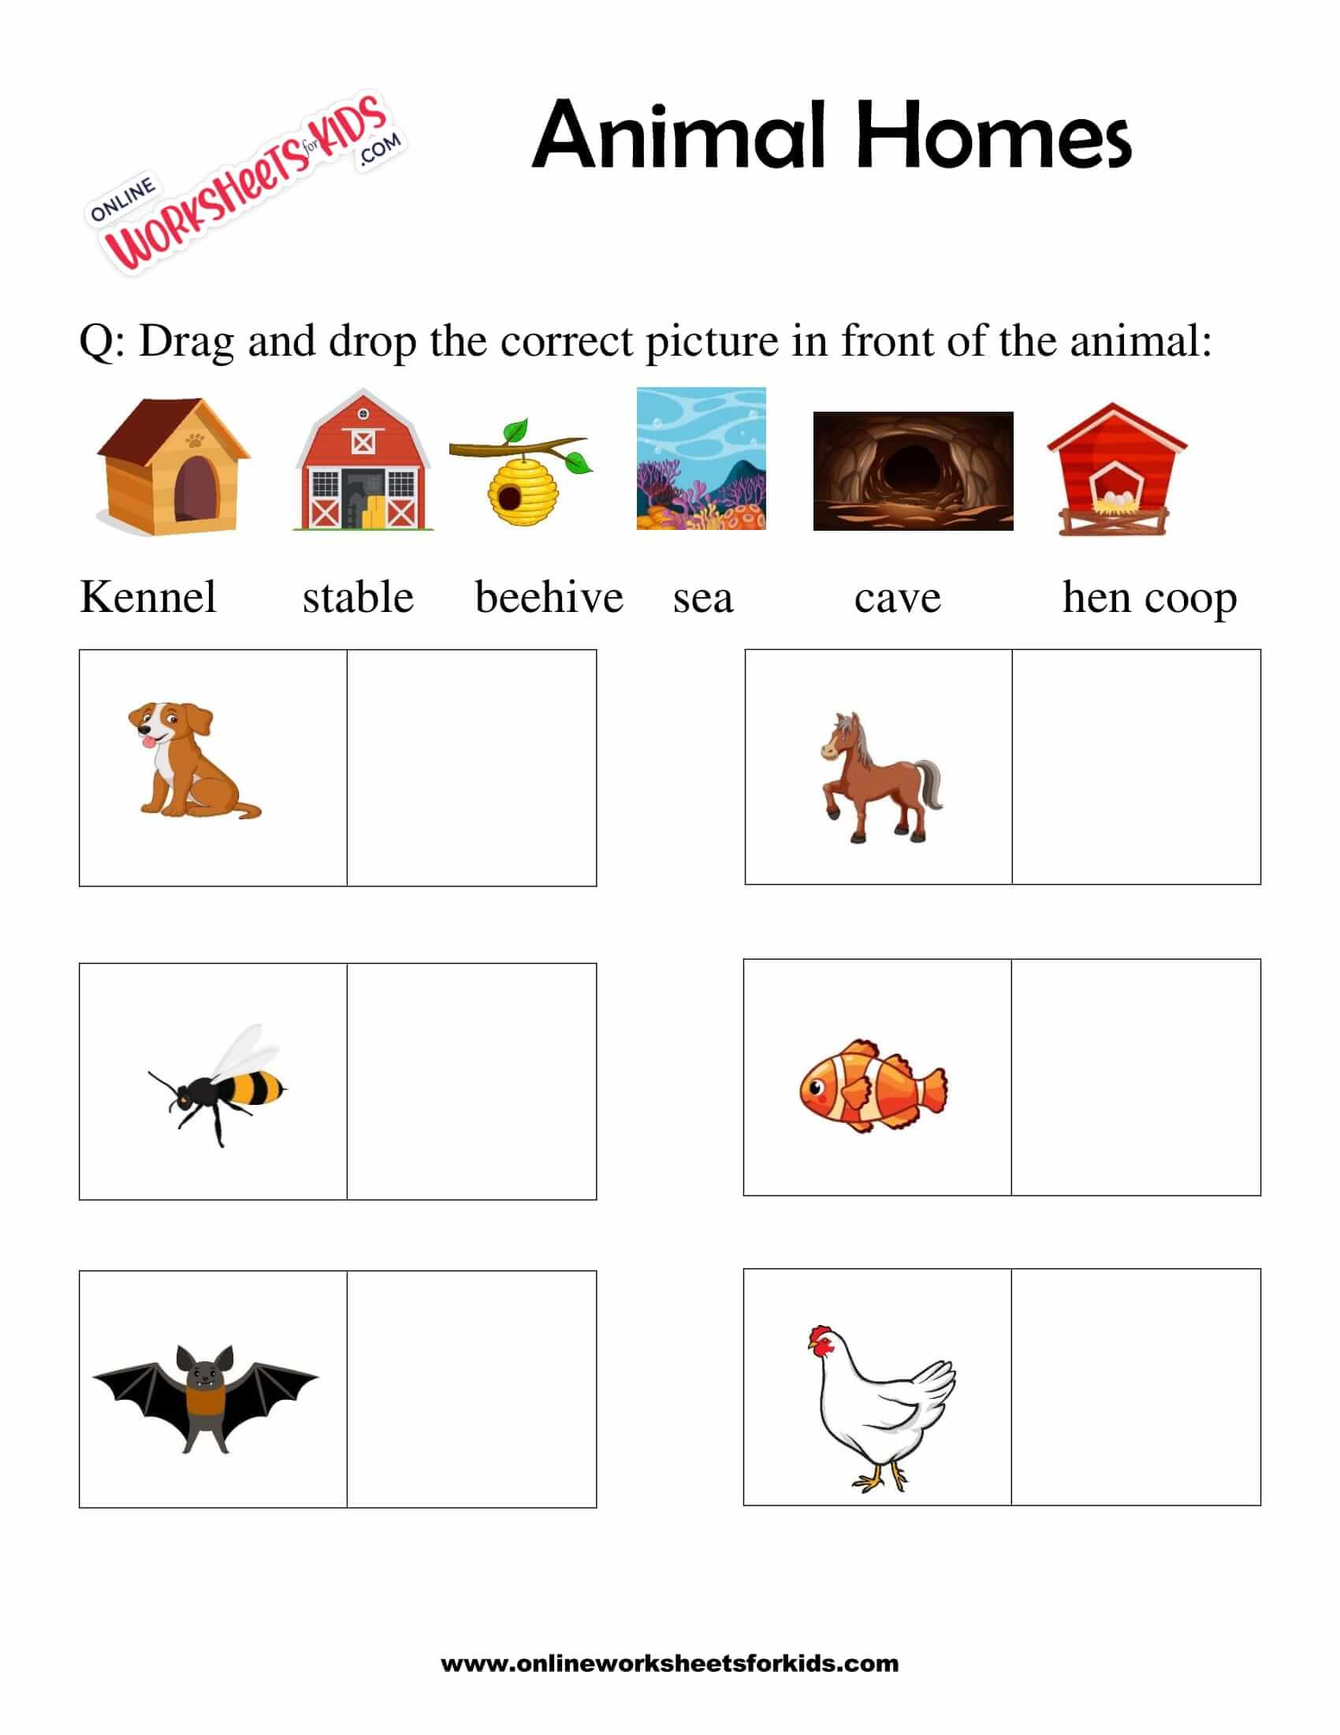
GROUP 1
Task 2: Cut and paste each animal home in front of the animal

Slide 48
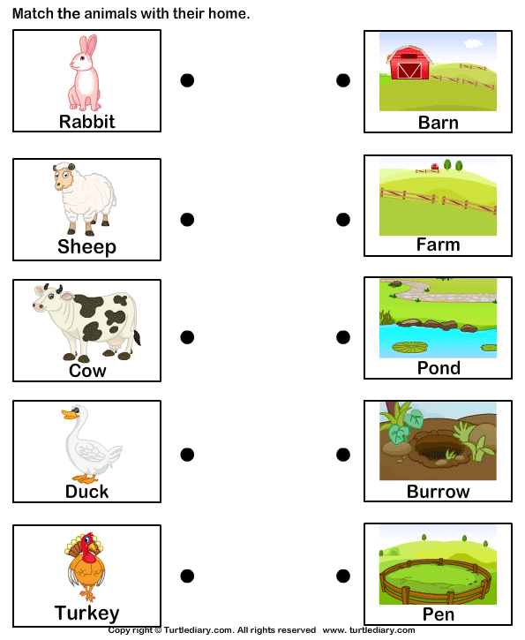

GROUP 2
Task 1: Match the images on the left with their corresponding images on the right.

Slide 49





GROUP 2
Task 2: Identify the type of animal that lives each picture below.
 |  | cave
 |  | kennel
 |  | den
 |  | pond
 |  | coop

Slide 50
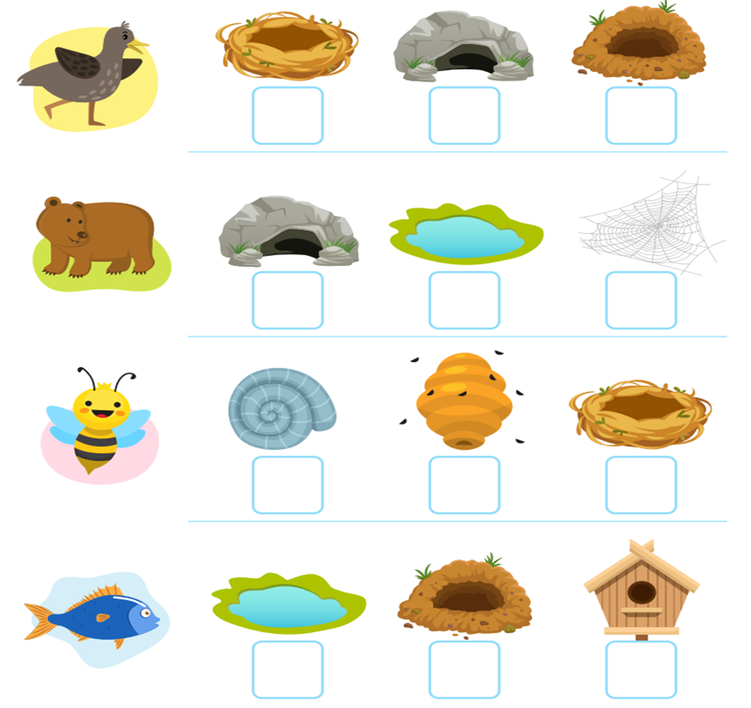
Group 3
Task 1: All living things need shelter to protect them. Tick √ the correct animal home.

Slide 51
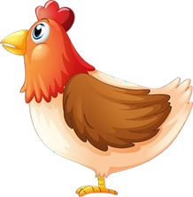
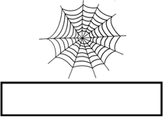

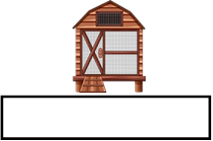


GROUP 3
chicken coop cave coral reefs spiderweb
Task 2: Write in the name of the home.

Slide 52
Week 10
Recognise and identify the South African coins, R1,R2, R5 and the bank notes R10, R20, R50, R100 and R200

Slide 53
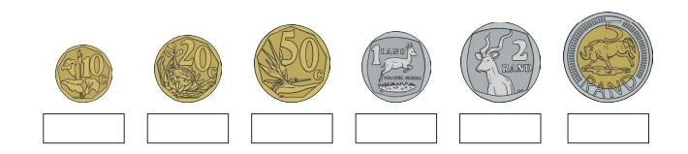
Group 1
Task 1: Say the correct value of each South African coin.

Slide 54
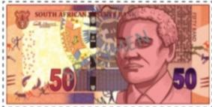
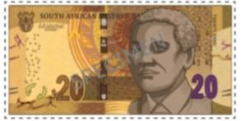
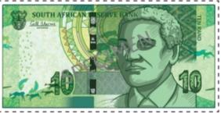
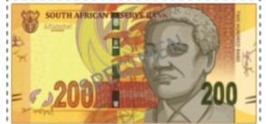
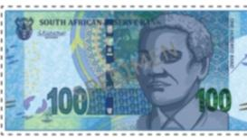
Group 1
Task 2: Say the correct value of each South African note.

Slide 55
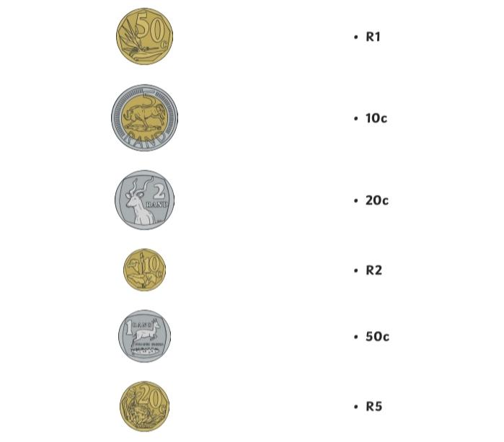
Group 2
Task 1: Match the coin with the correct value.

Slide 56
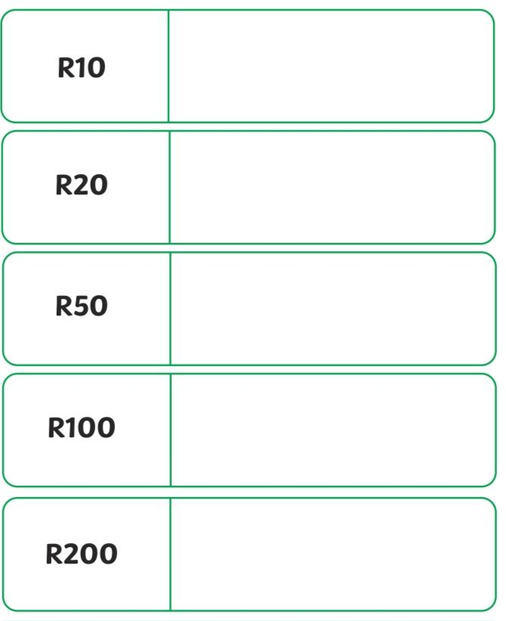
GROUP 2
Task 2: Cut and stick the bank notes in the right place.

Slide 57
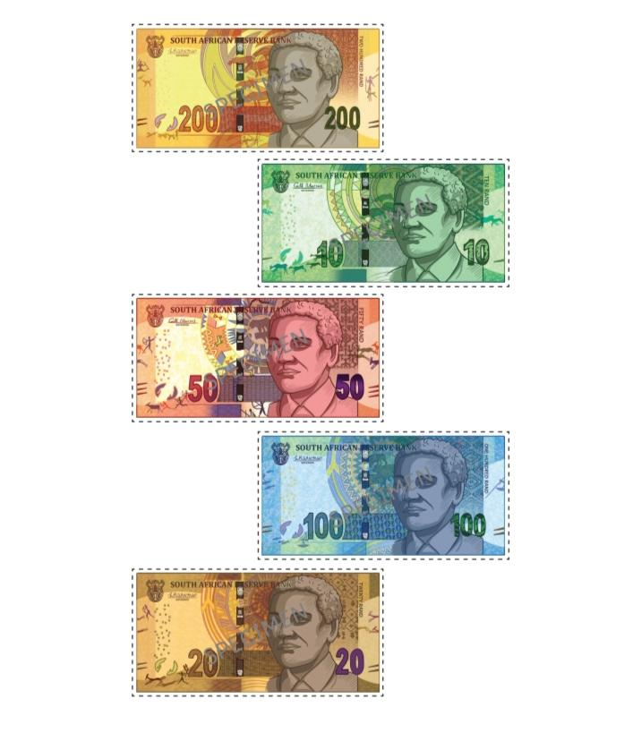

Task 2 cont…

Slide 58
Group 3
Task 1: Write the correct value under each coin.

Slide 59
Group 3
Task 2: Write the correct value under each note.

Slide 60
Resources
www.k5learning.com
www. sparklebox.co.uk
www.twinkl.co.za
www.Pinterest.com
DBE Mathematics grade 1 book 1 and 2
DBE Mathematics grade 1 book 3 and 4

